Slide 1
Binary Search Tree (BST)
(Successor, predecessor, Deletion)

Slide 2
Overview
Binary trees Ch 12.2–3
Trees Ch 10.4, 12.1

Slide 3

Successor and predecessor in BST
Defined in terms of order of in-order tree walk
Assume unique keys
  Successor of x: the node with the smallest key greater than x.key
  Predecessor of x: the node with the largest key smaller than x.key
Binary trees Ch 12.2–3

Slide 4
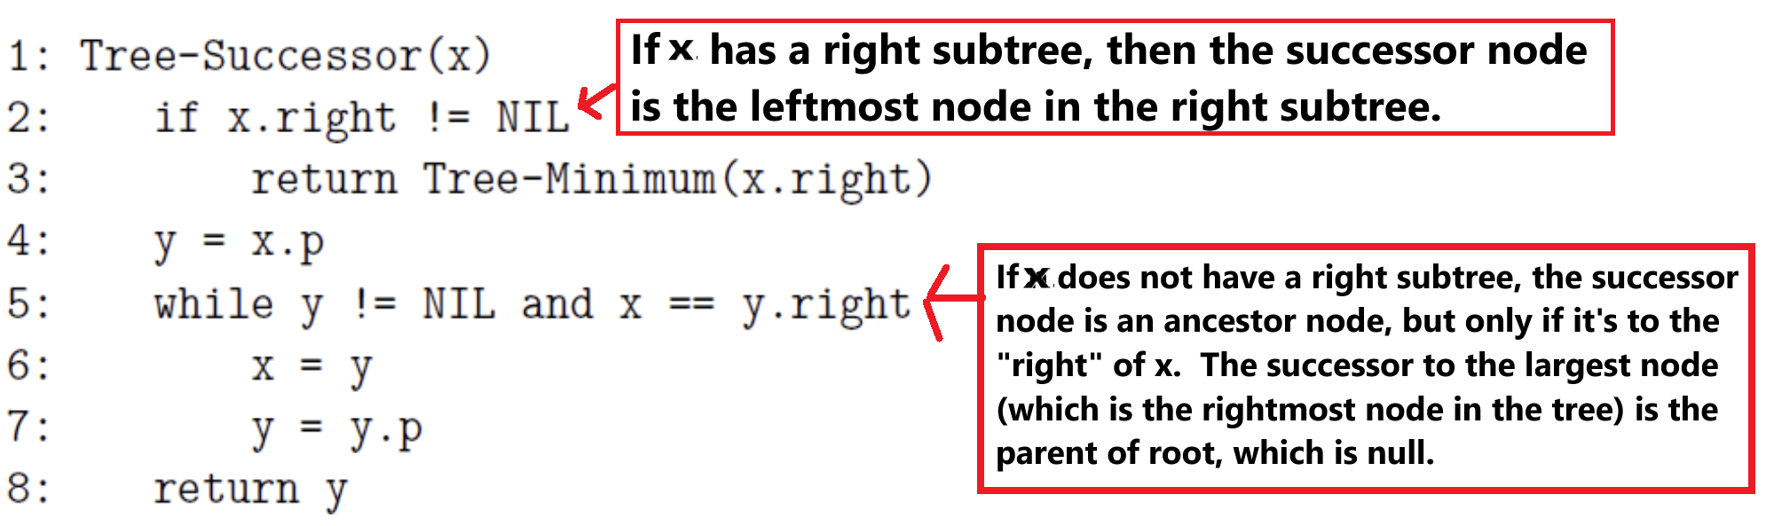
Tree Successor
Binary trees Ch 12.2–3

Slide 5
Tree Successor
1 ALGORITHM inOrder_successor(root, x)
5 # here, y is the successor and x is the current node
6
7 # Case 1 - Right Subtree of X Exists
8 IF x.right != Null THEN
9 # Successor is the leftmost node of the right subtree
10 RETURN get_min(x.right)
11
12 # Case 2 - Right Subtree of X Doesn't Exist
13 # Move up the tree as long as the node is a right child
14 y <- x.parent
15 WHILE y is not Null and x == y.right DO
16 x <- y
17 y <- y.parent
18 RETURN y ## Case3--if x is parents's left child,
19 ##then parent is the successor
Binary trees Ch 12.2–3

Slide 6
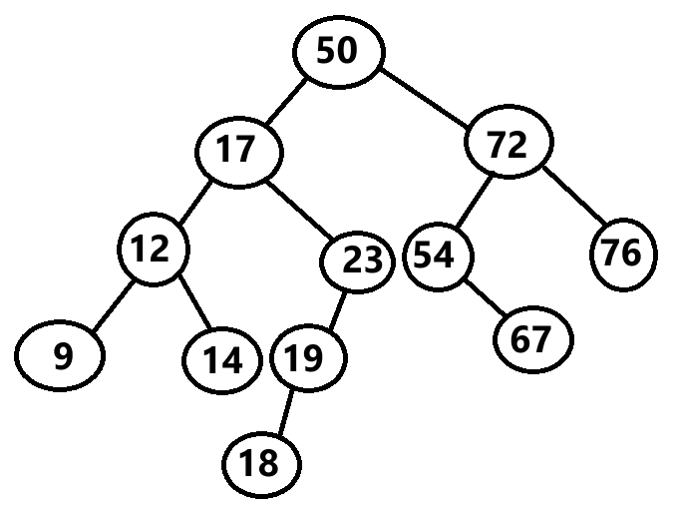
Successor (Important!)
find successor(17)
find successor(23)
find successor(19)
find successor(76)
Binary trees Ch 12.2–3

Slide 7
Successor
find successor(17): [Case01]
- right sub-tree exists
- get the leftmost node (min value) of the right subtree
- ans:18
find successor(23): [Case02]
- right sub-tree does not exist
- Loop: right child--Then, start going to the parent as long as it's the left child of its parents or y becomes Null.
- Here, x = current node, y=successor
- Step01: x(current)=23, y(successor)=17
- Step02: x(current)=17, y(successor)=50 (end of loop left branching--loop exits)
- ans:50
Binary trees Ch 12.2–3

Slide 8
Successor
find successor(19): [Case03]
- right sub-tree does not exist
- x is left child of parent
--Then, the successor is the parent of 19 which is 23
- ans:23
find successor(76): [Case02]
- right sub-tree does not exist
- right child--Then, start going to the parent as long as left branching exists or y becomes Null.
- Here, x = current node, y=successor
- Step01: x(current)=76, y(successor)=72
- Step02: x(current)=72, y(successor)=50
- Step03: x(current)=50, y(successor)=Null (y==Null, loop will end)
- ans:None/Null
Binary trees Ch 12.2–3

Slide 9
Predecessor
1 ALGORITHM inOrder_predecessor(root, x)
5 # here, y is the predecessor and x is the current node
6
7 # Case 1 - Left Subtree of X Exists
8 IF x.left != Null THEN
9 # predecessor is the right most node of the left subtree
10 RETURN get_max(x.left)
11
12 # Case 2 - Left Subtree of X Doesn't Exist
13 # Move up the tree as long as the node is a left child
14 y <- x.parent
15 WHILE y is not Null and x == y.left DO
16 x <- y
17 y <- y.parent
18 RETURN y ## Case3--if x is parents's right child,
19 ## then parent is the predecessor
Binary trees Ch 12.2–3

Slide 10
Predecessor (Important!)
find predecessor(17)
find predecessor(23)
find predecessor(19)
find predecessor(76)
find predecessor(9)
Binary trees Ch 12.2–3

Slide 11
Predecessor
find predecessor(17): [Case01]
Left sub-tree exists
Get the rightmost node (max value) of the left subtree.
Answer: 14
find predecessor(23): [Case01]
Left sub-tree exists
Get the rightmost node (max value) of the left subtree.
Answer: 19
Binary trees Ch 12.2–3

Slide 12
Predecessor
find predecessor(19): [Case01]
Left sub-tree exists
Get the rightmost node (max value) of the left subtree.
Answer: 18
find predecessor(76): [Case03]
Left sub-tree does not exist
right child of parent--Then, predecessor is the parent which is 72.
Answer: 72
Binary trees Ch 12.2–3

Slide 13
Predecessor
find predecessor(9): [Case02]
Left sub-tree does not exist
LOOP: left child of its parent--Then, start going to the parent as long as its the left child or y becomes Null.
- Here, x = current node, y=predecessor
- Step01: x(current)=9, y(predecessor)=12
- Step02: x(current)=12, y(predecessor)=17
- Step03: x(current)=17, y(predecessor)=50
- Step04: x(current)=50, y(predecessor)=Null
(y==Null, loop will end)
Answer: None/Null
Binary trees Ch 12.2–3

Slide 14
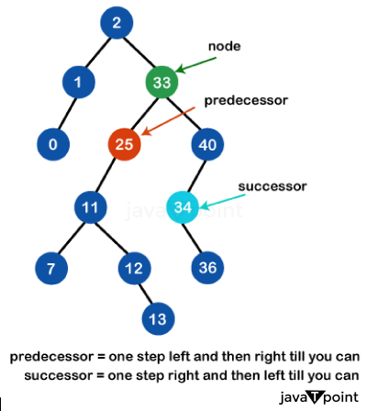
Successor and Predecessor
Image Source: https://www.javatpoint.com/inorder-predecessor-and-successor-in-a-binary-search-tree

Slide 15
Successor and Predecessor
IMPORTANT: REMEMBER THIS!!!!!
Largest element in BST does not have successor (None/Null)
Smallest element in BST does not have predecessor (None/Null)
Image Source: https://www.javatpoint.com/inorder-predecessor-and-successor-in-a-binary-search-tree

Slide 16
Shortcut to Find Successor & Predecessor in BST
Step1: Perform inorder traversal → yields nodes in ascending order.
Step2: For a node x:
  Successor = element immediately after x
  Predecessor = element immediately before x
Image Source: https://www.javatpoint.com/inorder-predecessor-and-successor-in-a-binary-search-tree

Slide 17
Shortcut to Find Successor & Predecessor in BST
find successor(17)= 18
find successor(23)= 50
find successor(19)= 23
find successor(76)= Null
In-order traversal: Null 9 12 14 17 18 19 23 50 54 67 72 76 Null
Image Source: https://www.javatpoint.com/inorder-predecessor-and-successor-in-a-binary-search-tree

Slide 18
Shortcut to Find Successor & Predecessor in BST
find predecessor(17)= 14
find predecessor(23)= 19
find predecessor(19)= 18
find predecessor(76)= 72
find predecessor(9)= Null
In-order traversal: None 9 12 14 17 18 19 23 50 54 67 72 76 None
Image Source: https://www.javatpoint.com/inorder-predecessor-and-successor-in-a-binary-search-tree

Slide 19
Deletion in BST (Important!)
Deletion
Let z be the node to delete
Three basic cases
  Case1: z has no children: delete z, set corresponding child pointer in z.p to NIL
  Case2: z has one child y: Ensure the deleted node's child is connected to the deleted node's parent.
  Case3: z has two children: replace z by either its (IMPORTANT!!!)
    Inorder successor
    Inorder predecessor
Then, recursively call that duplicate value to be deleted from the sub-tree.
IMPORTANT: REMEMBER CASES!!!!!
Binary trees Ch 12.2–3

Slide 20
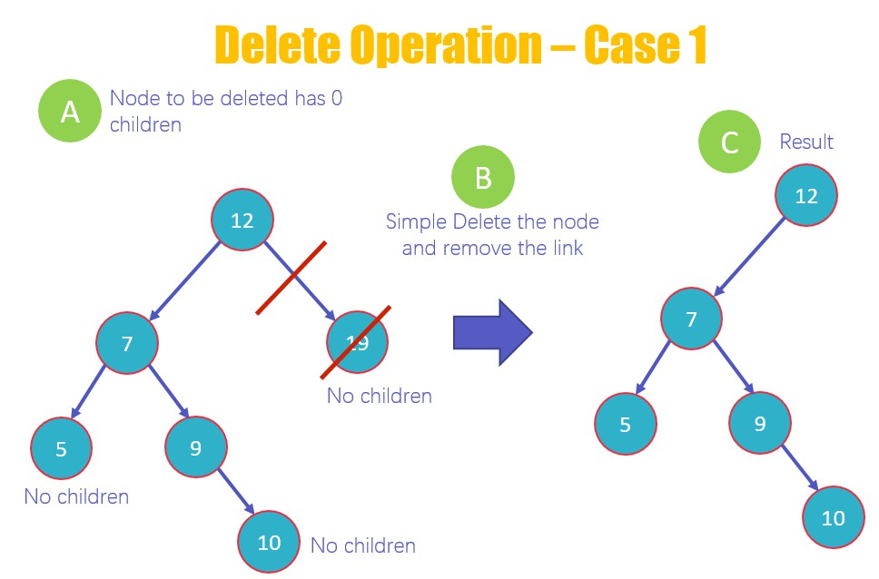
Deletion (Case01:If No Children (Leaf Node))
Image Source: https://www.guru99.com/binary-search-tree-data-structure.html

Slide 21
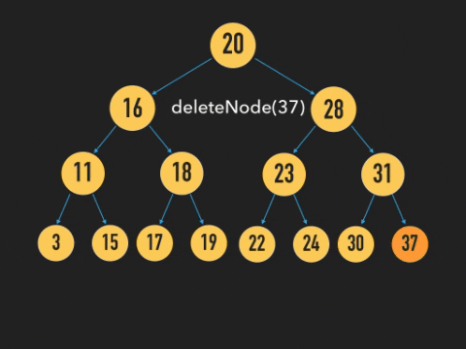
Deletion (Case01:If No Children (Leaf Node))

Slide 22
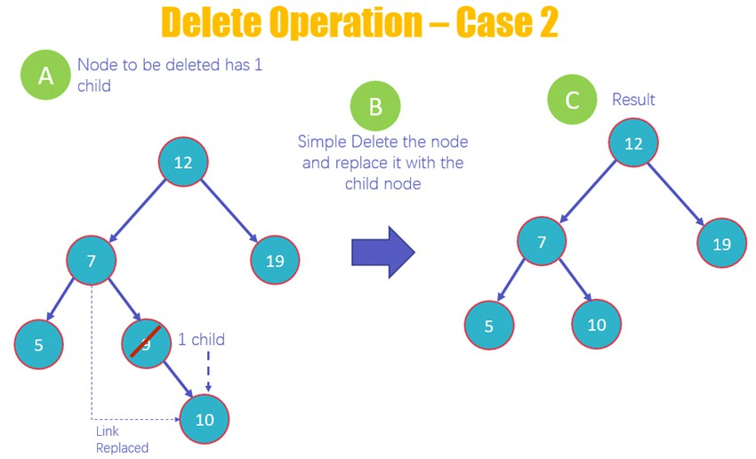
Deletion (Case02: If Only One Children exists)
Image Source: https://www.guru99.com/binary-search-tree-data-structure.html

Slide 23
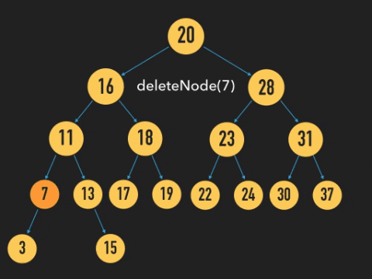
Deletion (Case02: If Only One Children exists)

Slide 24
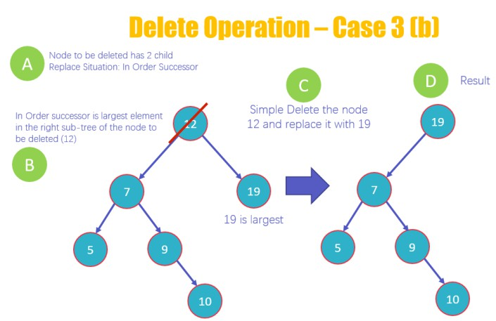
Deletion (Case03: If both Children exists)
Image Source: https://www.guru99.com/binary-search-tree-data-structure.html

Slide 25
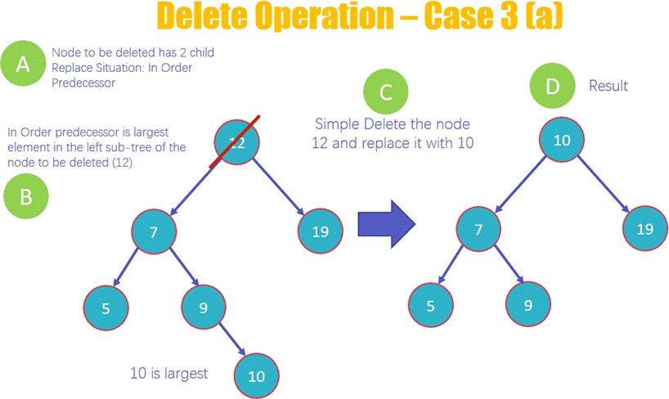
Deletion (Case03: If both Children exists)
Image Source: https://www.guru99.com/binary-search-tree-data-structure.html

Slide 26
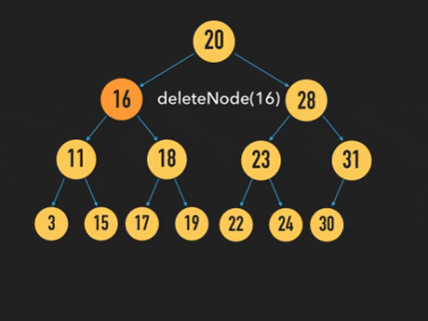
Deletion (Case03: If both Children exists)

Slide 27
Deletion in BST (Basic Steps)
Find the node to delete
  Start from the root.
  If key < current.val → go left.
  If key > current.val → go right.
  Continue until the target node is found.
Delete the node based on its case
  Case 1: No child
    Remove the node directly.
  Case 2: One child
    Connect the node’s parent directly to its child.
  Case 3: Two children
    Find either:
      Predecessor → maximum node in the left subtree, or
      Successor → minimum node in the right subtree.
    Replace the target node’s value with the predecessor/successor value.
    Recursively delete the duplicate predecessor/successor node from its original subtree.

Slide 28
Deletion Using In-order-successor
public static TNode delete_with_successor(TNode root, int key) {
if (root == null) {
return root; // Base case: Tree is empty or node not found
}
// Traverse to the left subtree if key is smaller
if (key < root.val) {
root.left = delete_with_successor(root.left, key);
}
// Traverse to the right subtree if key is larger
else if (key > root.val) {
root.right = delete_with_successor(root.right, key);
}
else {
//Match found—delete it (In next slide)
}
return root;
}

Slide 29
Deletion Using In-order-successor
public static TNode delete_with_successor(TNode root, int key) {
else { //Match found—delete it
// ==== Case 1 | No subtree or children ====
if (root.left == null && root.right == null) {
return null; // Simply delete the node
}
// ==== Case 2 | One subtree (one child) ====
else if (root.left == null) { // Only right child exists
root.right.parent = root.parent; // Connect child to parent
return root.right;
}
else if (root.right == null) { // Only left child exists
root.left.parent = root.parent; // Connect child to parent
return root.left;
}
// ==== Case 3 | Two subtrees (two children) ====
else {
// Find in-order successor (leftmost node in right subtree)
TNode succ = BSTDemo.getMin(root.right);
root.val = succ.val; // Replace value with successor's value
// Delete the in-order successor node recursively
root.right = delete_with_successor(root.right, succ.val);
}
}
return root;
}

Slide 30
Deletion Using In-order-successor
public static TNode delete_with_successor(TNode root, int key) { if (root == null) { return root; // Base case: Tree is empty or node not found } // Traverse to the left subtree if key is smaller if (key < root.val) { root.left = delete_with_successor(root.left, key); } // Traverse to the right subtree if key is larger else if (key > root.val) { root.right = delete_with_successor(root.right, key); } else { // ==== Case 1 | No subtree or children ==== if (root.left == null && root.right == null) { return null; // Simply delete the node } | // ==== Case 2 | One subtree (one child) ==== else if (root.left == null) { // Only right child exists root.right.parent = root.parent; // Connect child to parent return root.right; } else if (root.right == null) { // Only left child exists root.left.parent = root.parent; // Connect child to parent return root.left; } // ==== Case 3 | Two subtrees (two children) ==== else { // Find in-order successor (leftmost node in right subtree) TNode succ = BSTDemo.getMin(root.right); root.val = succ.val; // Replace value with successor's value // Delete the in-order successor node recursively root.right = delete_with_successor(root.right, succ.val); } } return root; }

Slide 31
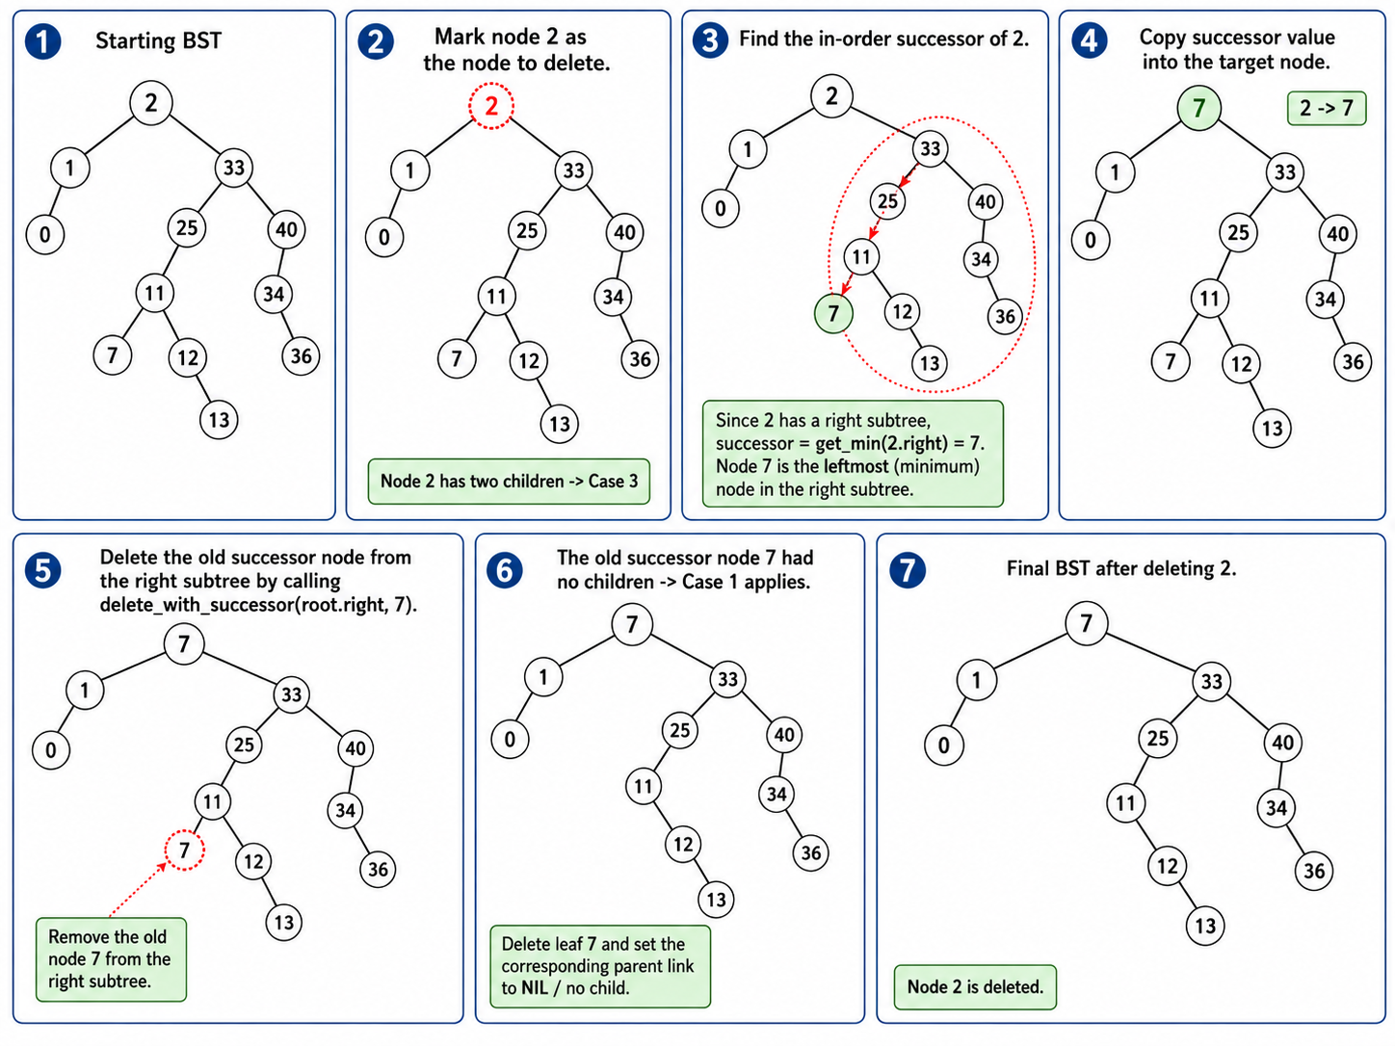
Deletion Using In-order-successor (Delete(2))

Slide 32
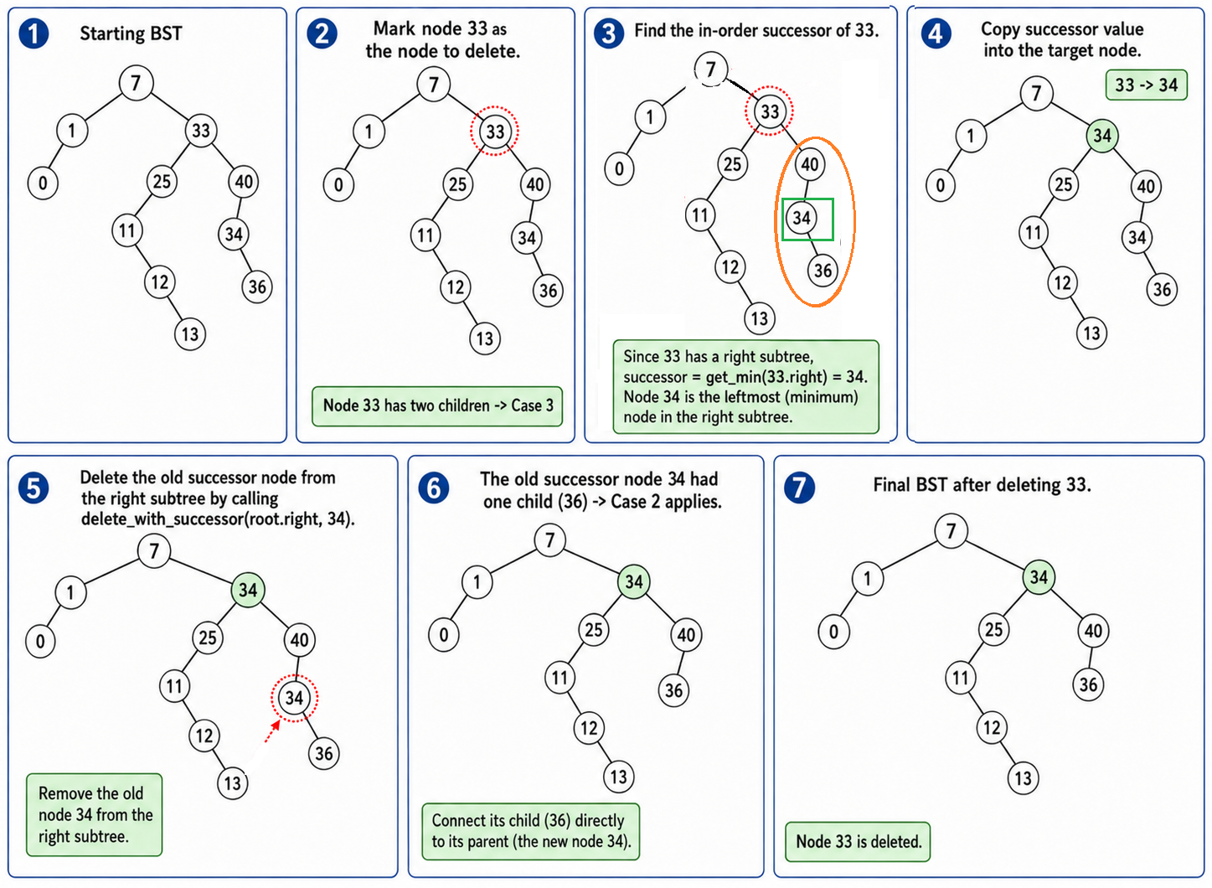
Deletion Using In-order-successor (Delete(33))

Slide 33
Deletion Using In-order-predecessor
public static TNode delete_with_predecessor(TNode root, int key) {
if (root == null) {
return root; // Base case: Tree is empty or node not found
}
// Traverse to the left subtree if key is smaller
if (key < root.val) {
root.left = delete_with_predecessor(root.left, key);
}
// Traverse to the right subtree if key is larger
else if (key > root.val) {
root.right = delete_with_predecessor(root.right, key);
}
else {
//Match found—delete it (In next slide)
}
return root;
}

Slide 34
Deletion Using In-order-predecessor
else {//Match found—delete it
// ==== Case 1 | No subtree or children ====
if (root.left == null && root.right == null) {
return null; // Simply delete the node
}
// ==== Case 2 | One subtree (one child) ====
else if (root.left == null) {
root.right.parent = root.parent;
return root.right;
}
else if (root.right == null) {
root.left.parent = root.parent;
return root.left;
}
// ==== Case 3 | Two subtrees (two children) ====
else {
// Find in-order predecessor (rightmost node in left subtree)
TNode pred = BSTDemo.getMax(root.left);
root.val = pred.val; // Replace value with predecessor's value
// Delete the in-order predecessor node recursively
root.left = delete_with_predecessor(root.left, pred.val);
}
}
return root;
}

Slide 35
Deletion Using In-order-predecessor
public static TNode delete_with_predecessor(TNode root, int key) { if (root == null) { return root; // Base case: Tree is empty or node not found } // Traverse to the left subtree if key is smaller if (key < root.val) { root.left = delete_with_predecessor(root.left, key); } // Traverse to the right subtree if key is larger else if (key > root.val) { root.right = delete_with_predecessor(root.right, key); } else { // ==== Case 1 | No subtree or children ==== if (root.left == null && root.right == null) { return null; // Simply delete the node } | // ==== Case 2 | One subtree (one child) ==== else if (root.left == null) { root.right.parent = root.parent; return root.right; } else if (root.right == null) { root.left.parent = root.parent; return root.left; } // ==== Case 3 | Two subtrees (two children) ==== else { // Find in-order predecessor (rightmost node in left subtree) TNode pred = BSTDemo.getMax(root.left); root.val = pred.val; // Replace value with predecessor's value // Delete the in-order predecessor node recursively root.left = delete_with_predecessor(root.left, pred.val); } } return root; }

Slide 36
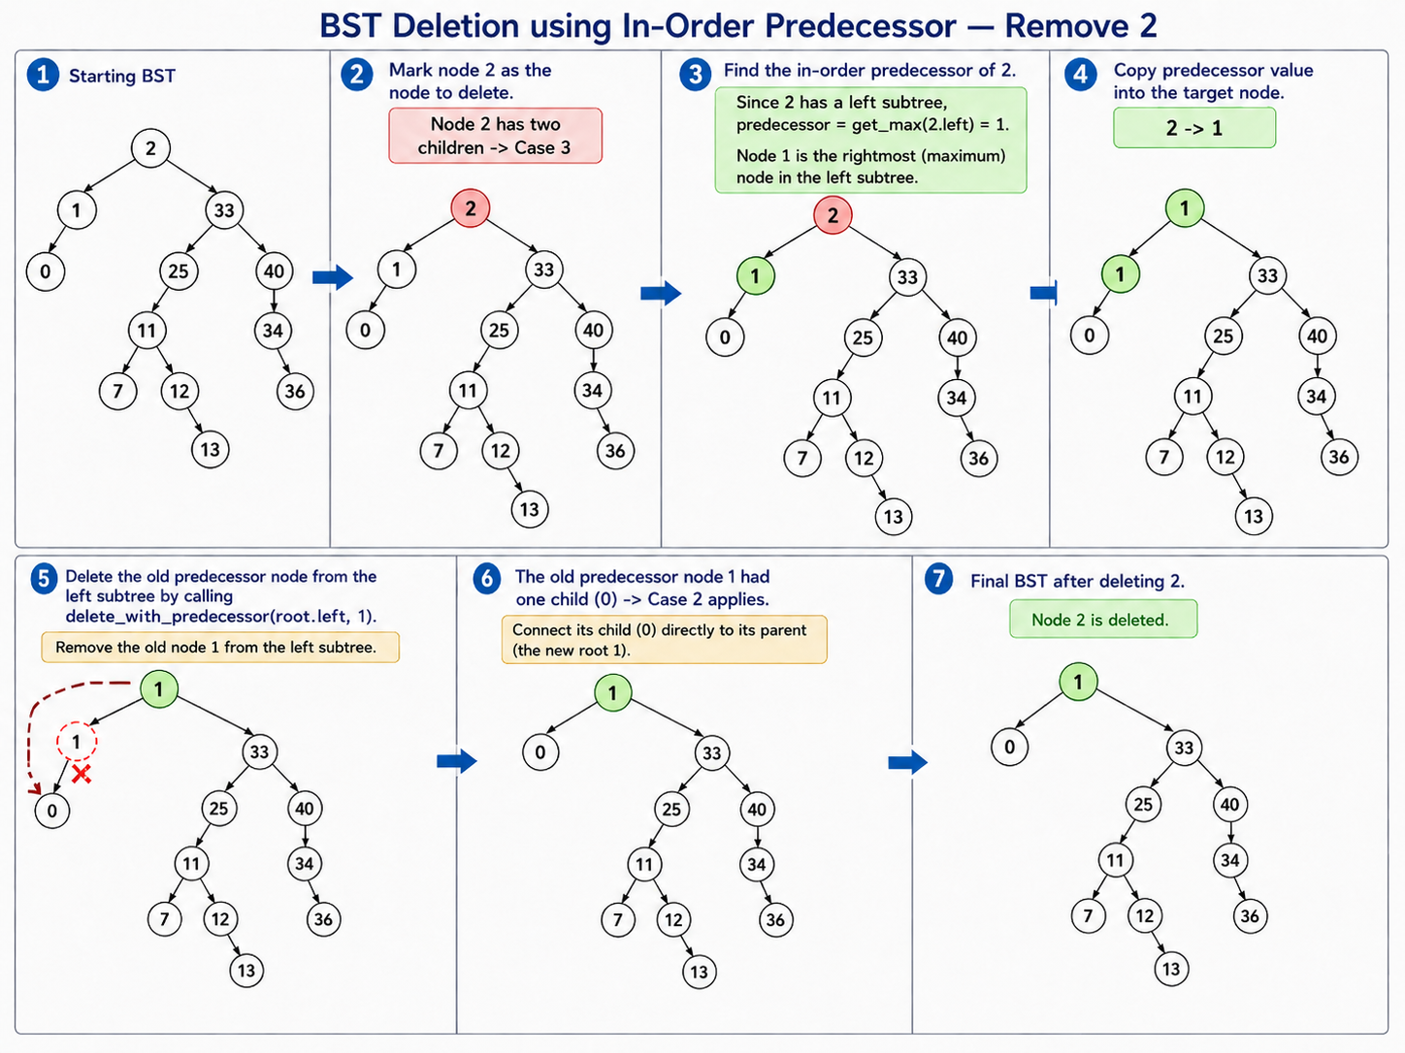
Deletion Using In-order-predecessor (Delete(2))

Slide 37
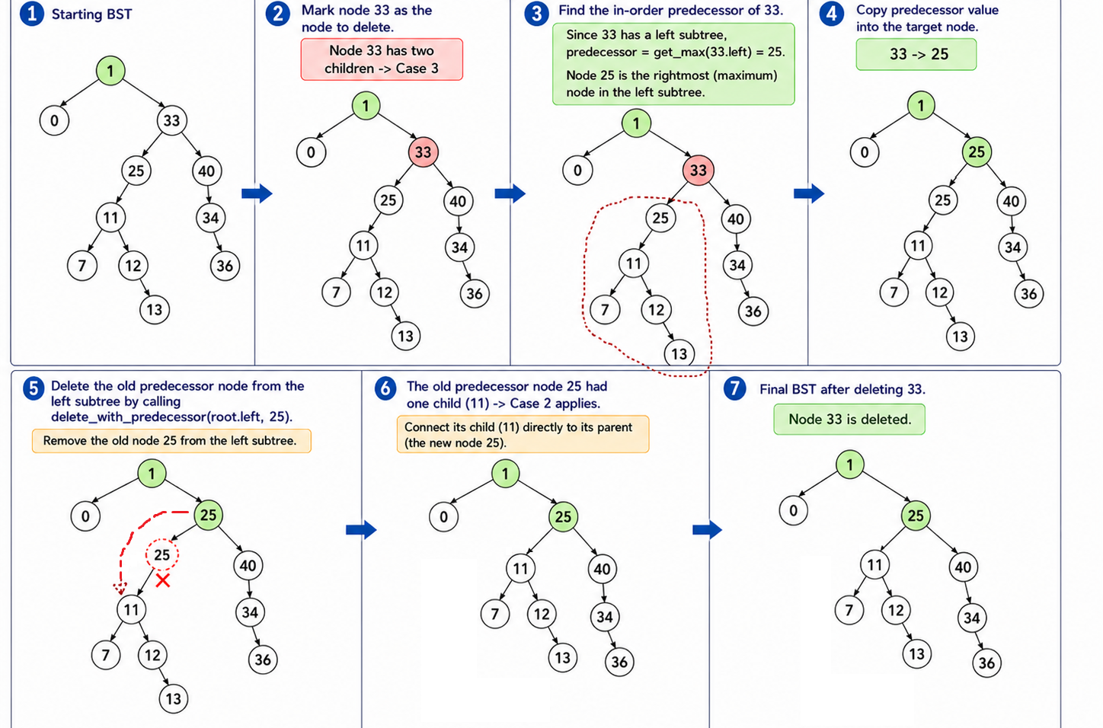
Deletion Using In-order-predecessor (Delete(33))

Slide 38
Try out Interactive Simulation by Visualgo.net (https://visualgo.net/en/bst)
Interactive simulations

Slide 39
The End

